Slide 1
SimSchool - 1
Currently, you should have:
  Some basic classes for representing different types of people – students, college students, and teachers.
Your goal:
  Create a graphical visualization of the people who currently exist in your BackToSchool world.
Your limitations:
  You must use processing to create a window and draw into it.

Slide 2
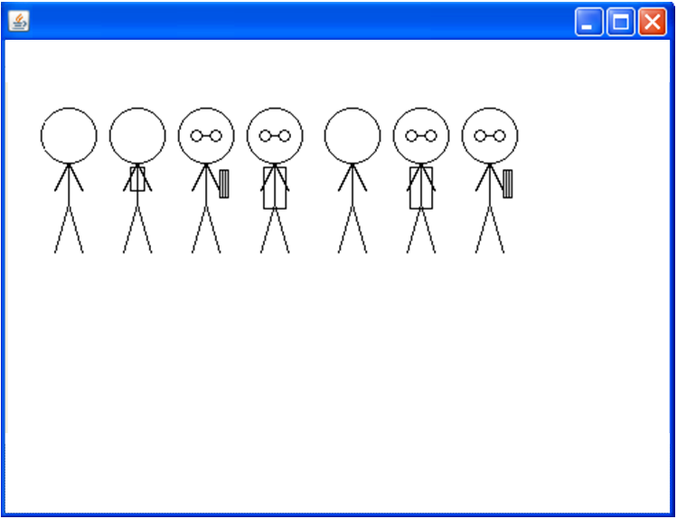
An Example

Slide 3
SimSchool Update
Open up your SimSchool project.
Download Violet UML Creator from our course locker on School Loop (or google for it!)
Create a UML diagram that shows the relationships between your existing SimSchool structures (classes/interfaces).

Slide 4
SimSchool Planning UML
From this point on, when you receive a new SimSchool goal, the first thing to change is the UML.
  Think carefully about the new goal
  Add classes you think you'll need to the UML (even though they don't exist yet)
  Connect your new classes to the existing ones with plausible relationships
  Now go to Eclipse and actually implement the new functionality.

Slide 5
SimSchool - 2
Currently, you should have:
  Some classes for representing different types of people – students, college students, and teachers. They are graphically represented on the screen via classes available in processing and possibly your shapes library.
Your goal:
  Read in people from a file so that actual client data can be used.
Your limitations:
  The data file will be in the format provided.

